Slide 1
Modeling and Simulation of Aircraft Evacuations
by Jingxin Han and Stephen Otunba

Slide 2
Topics
Goals and Objectives
Modeling
2D Versus 3D
Exterior Modeling
Interior Modeling
VRML
Software
Problems Encountered and Future Goals

Slide 3
GOALS AND OBJECTIVES
In this project, we will simulate an evacuation behavior in an aircraft using a crowd component.
In passed years, there has only 2D simulation and this application can be used by airlines to simulate emergency scenarios without the use of live actors.
This will allow airlines to run multiple simulation under a variety of conditions which will save time and lower costs. The application can also be adapted and expanded to other industries.

Slide 4
MODELING
Modeling was done in 3D Studio Max
Outer aircraft environment and aircraft model
simple models downloaded from 3dviastudio.com were imported into 3ds Max
Inner aircraft environment
A model of the cross section of the interior of an aircraft as well as the passenger models were also downloaded from 3dviastudio.com
Biped models were inserted into the passenger models to create the evacuation animations.

Slide 5
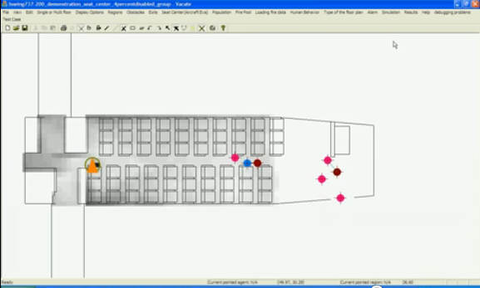
2D versus 3D

Slide 6
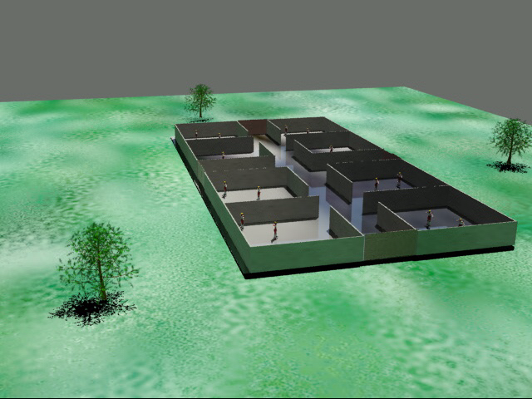
2D versus 3D

Slide 7
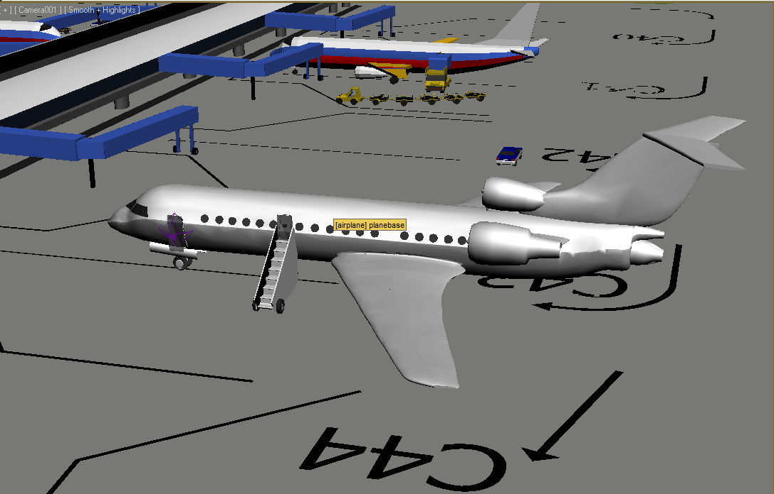
Exterior Modeling

Slide 8
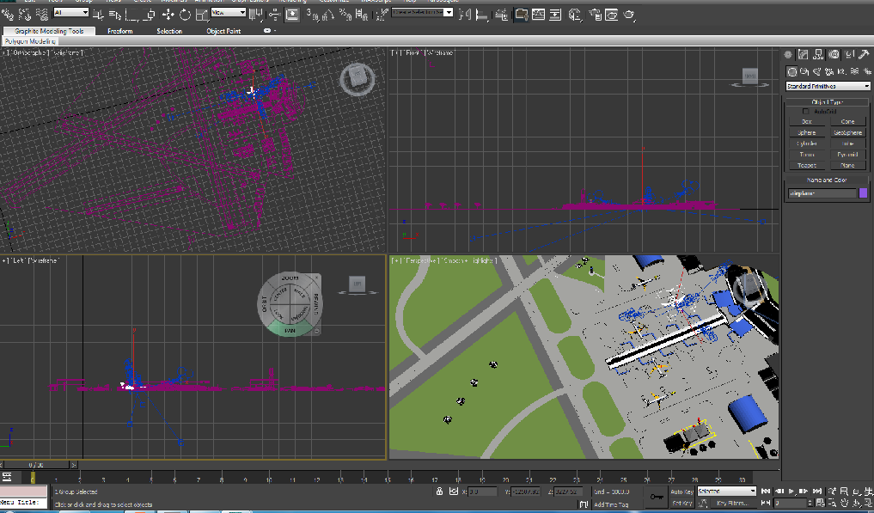
Exterior Modeling in 3ds max

Slide 9
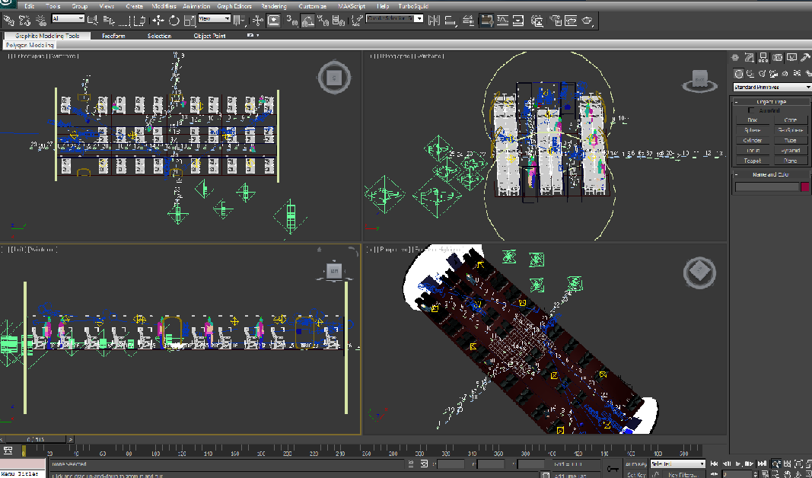
Interior Modeling in 3ds max

Slide 10
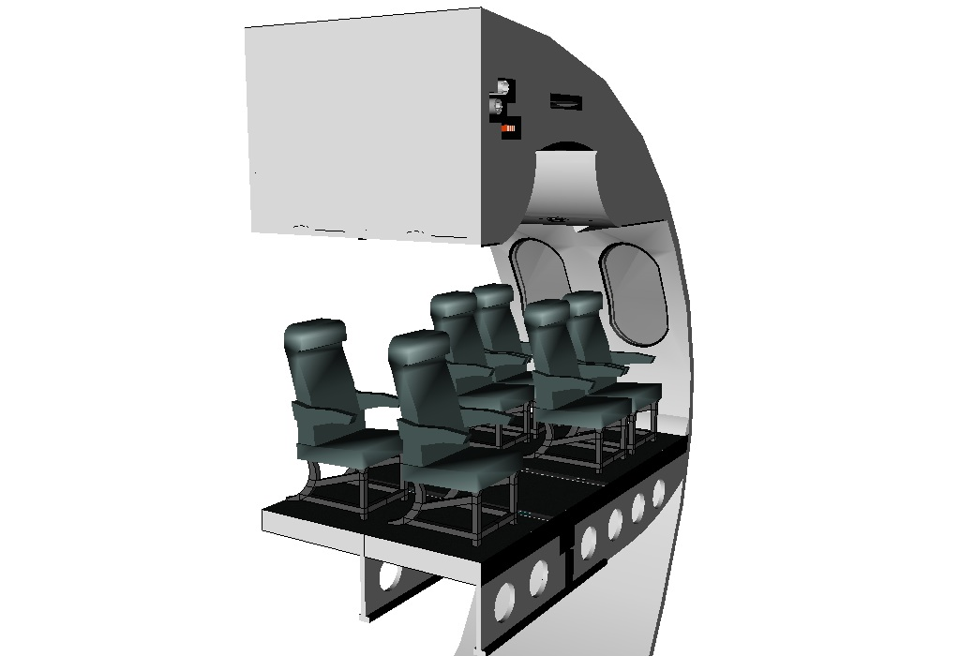
Cross Section of Plane Interior

Slide 11
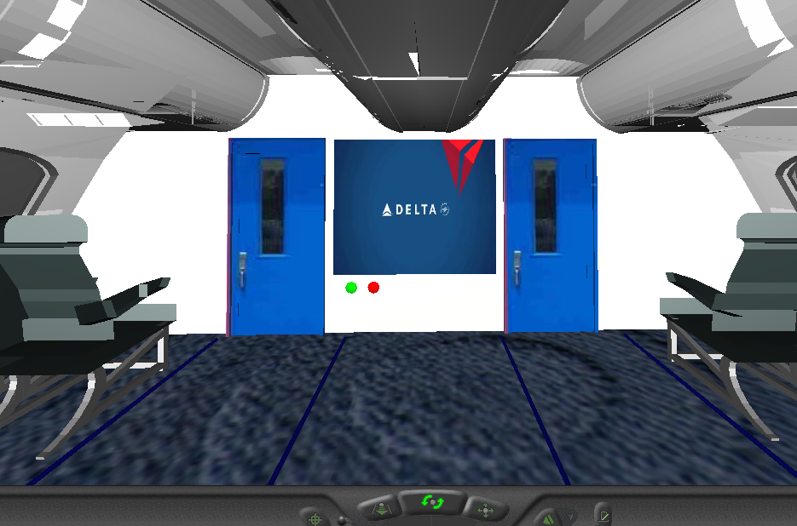
Front of Plane Cabin

Slide 12
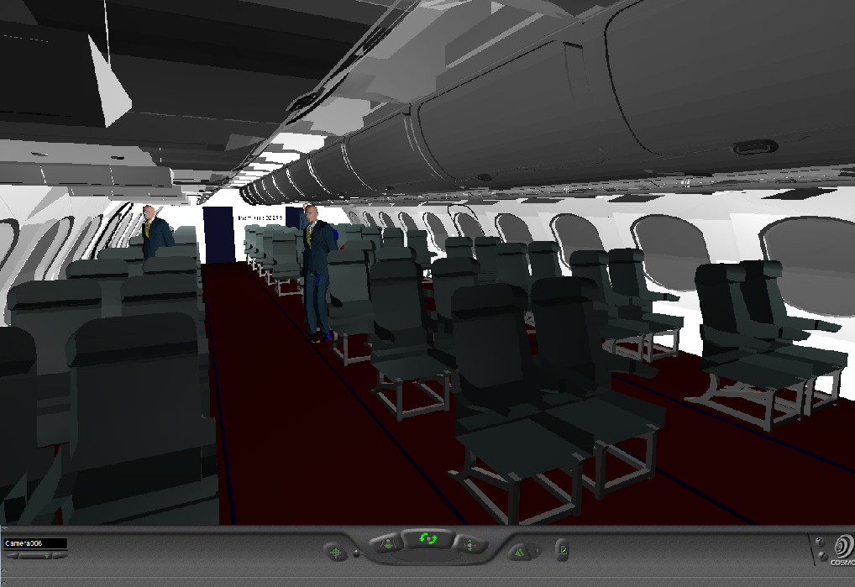
Plane Cabin

Slide 13
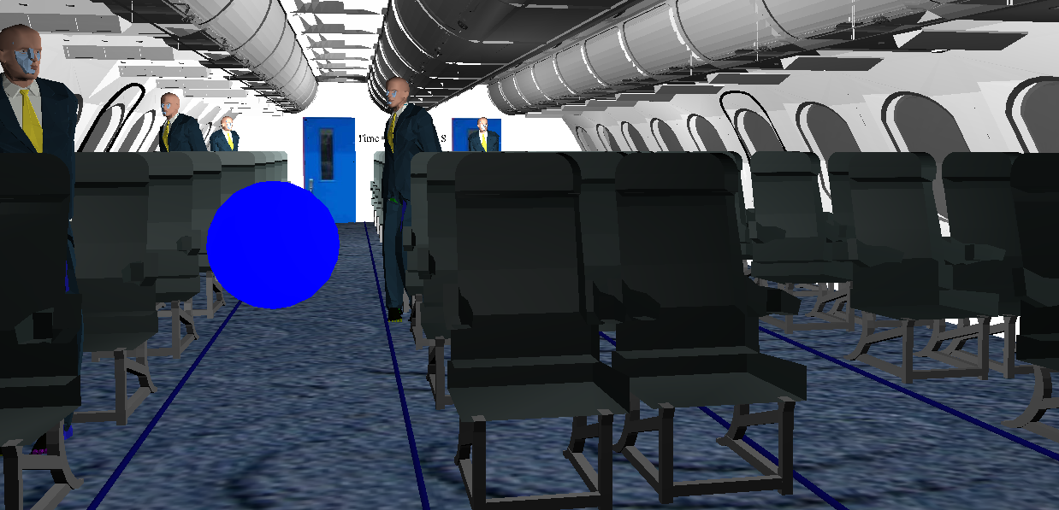
Cabin & Passengers

Slide 14
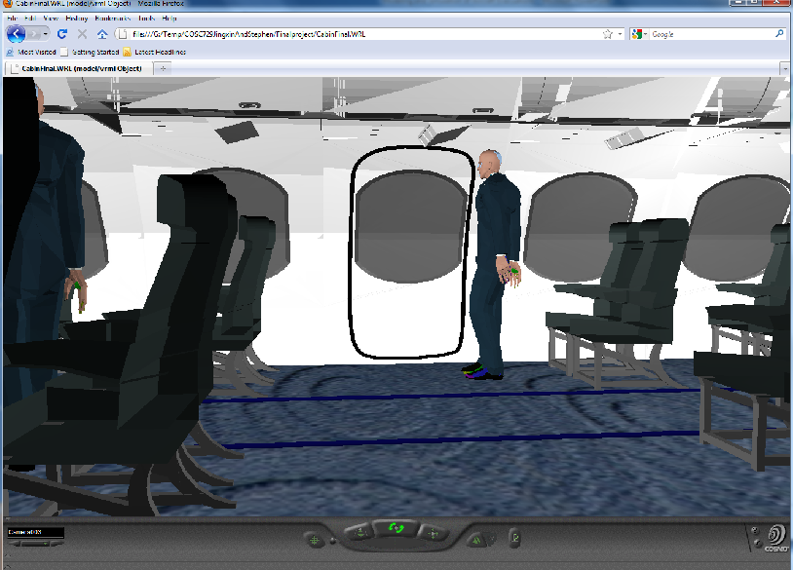
Passenger Exit

Slide 15
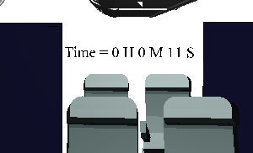
VRML
VRML was used to add functionality to the virtual environment through the incorporation of:
Touch Sensors
Lights
Time Counter
Interpolators

Slide 16
Lights
Outer aircraft we used the standard daylight system that is available in 3ds Max.
In the aircraft we used multiple point lights to illuminate the interior of the cabin.
Emergency guide lines were added on either side of the aisles.

Slide 17
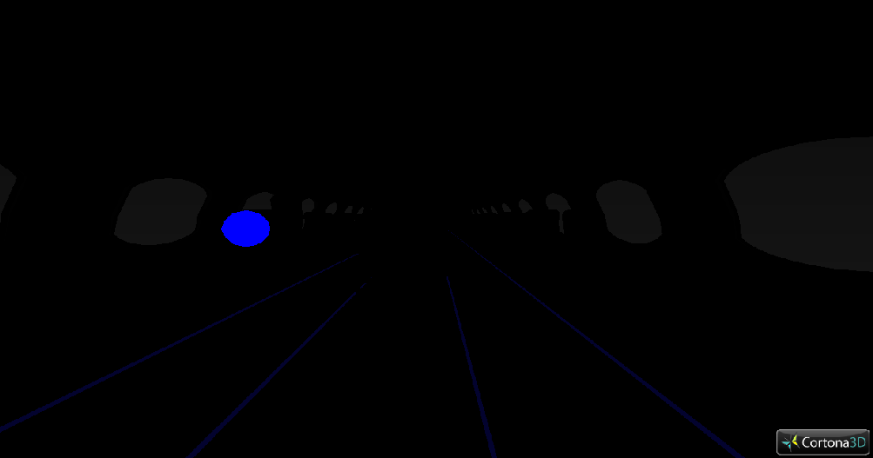
Light

Slide 18
Sensors
Touch sensors were placed on the emergency button, the outer aircraft doors, the buttons controlling the television screen, as well as on the heads of each of the passengers.
The touch sensors controlled video and audio playback as well as animation.
A time counter was placed on the back wall of the aircraft cabin to keep track the total elapsed time for the evacuation.

Slide 19
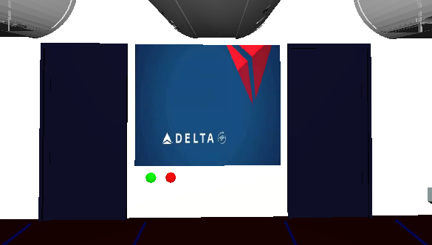
Interpolator
A scalar interpolator was applied to the television screen and triggered by touch sensors to turn the screen on and off.

Slide 20
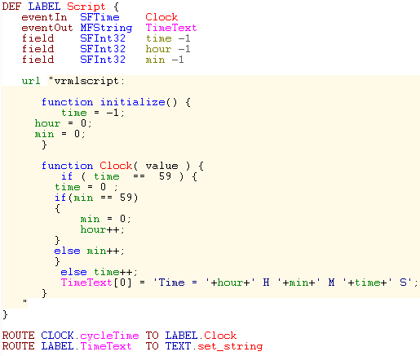
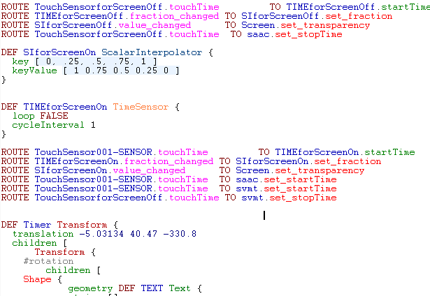
VMRL pad

Slide 21
Software
Autodesk 3ds Max 2011 64-bit
Autodesk Maya 2011 64-bit
Cosmo player
Vrml Pad
Windows 7 Enterprise 64-Version
FBX Converter
Mac OS
Virtools (if we can find a way to import/export files)

Slide 22
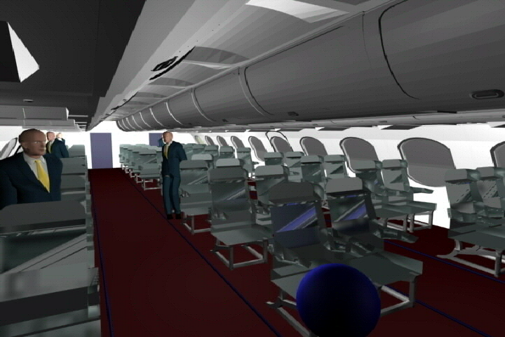
Evacuation Video

Slide 23
Demo
PlaneOutside.WRL

